Slide 1
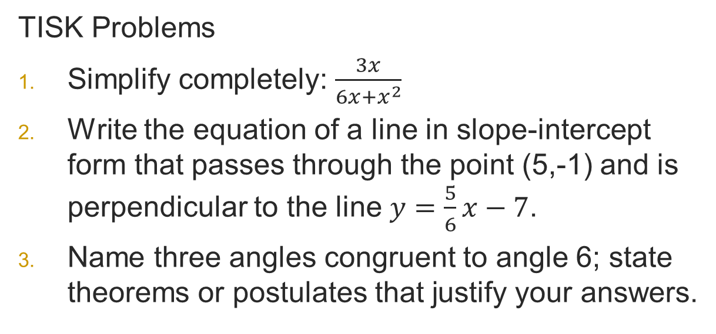
Tuesday, February 5, 2013 Agenda:
TISK, NO MM
Lesson 9-3: Arcs & Chords
HW Check (time)
Homework: §9-3 problems in packet
TISK Problems
Simplify completely: $\frac{3x}{6x+x^{2}}$
Write the equation of a line in slope-intercept form that passes through the point (5,-1) and is perpendicular to the line $y=\frac{5}{6}x−7$.
Name three angles congruent to angle 6; state theorems or postulates that justify your answers.
1
2
4
3
5
6
8
7

Slide 2
§9-3 Arcs & Chords
In the same circle, or in congruent circles, two minor arcs are congruent if and only if their corresponding chords are congruent.
A
B
C
D

Slide 3
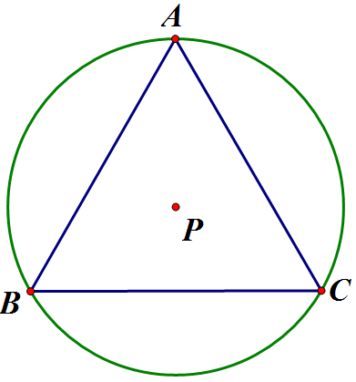


Example
Find the measure of each minor arc created when an equilateral triangle is inscribed in a circle.
Since $\overline{BC}≅\overline{AC},$ we know
Likewise, since $\overline{BC}≅\overline{AB},$ we know
From yesterday, we know that

Slide 4
Theorem
In a circle, if a diameter is perpendicular to a chord, then the diameter bisects the chord and its arc.
Notes:
Prove this in homework

Slide 5
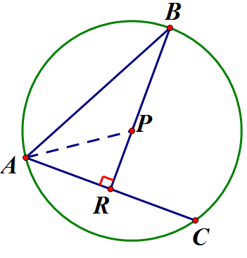

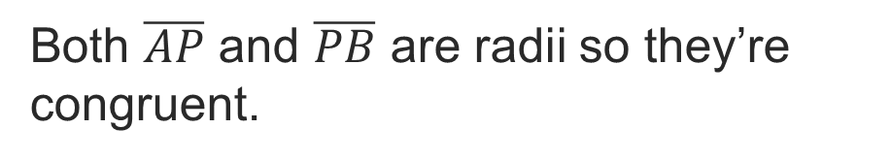
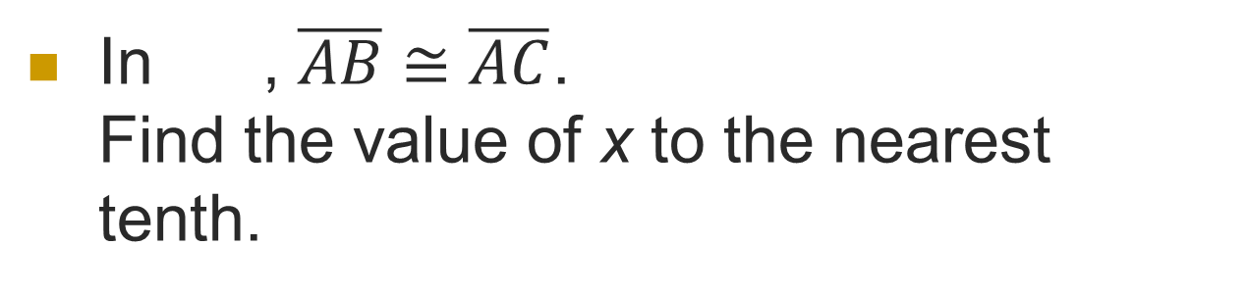


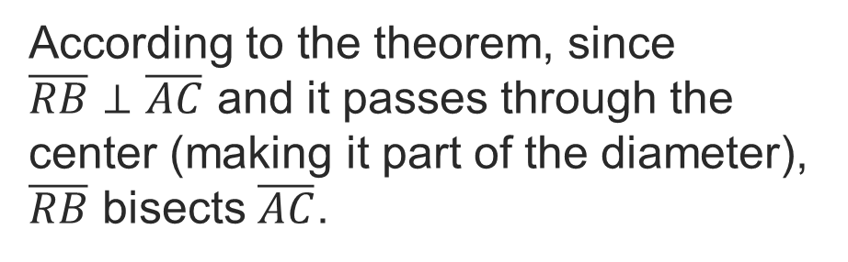




Example
In , $\overline{AB}≅\overline{AC}$.
Find the value of x to the nearest tenth.
Since $\overline{AB}≅\overline{AC}$, then $AC=6$.
According to the theorem, since $\overline{RB}⊥\overline{AC}$ and it passes through the center (making it part of the diameter), $\overline{RB}$ bisects $\overline{AC}$.
$$6$$
$$2\sqrt{3}$$
$$2\sqrt{3}$$
$$x$$
This means $AR=3$.
$$3$$
Both $\overline{AP}$ and $\overline{PB}$ are radii so they’re congruent.

Slide 6



Example
In , $\overline{AB}≅\overline{AC}$.
Find the value of x to the nearest tenth.
Then we can use the Pythagorean Theorem to solve for x.
$$6$$
$$2\sqrt{3}$$
$$a^{2}+b^{2}=c^{2}$$
$$2\sqrt{3}$$
$$3^{2}+x^{2}={(2\sqrt{3})}^{2}$$
$$x$$
$$9+x^{2}=12$$
$$3$$
$$x^{2}=3$$
$$x=\sqrt{3}$$

Slide 7
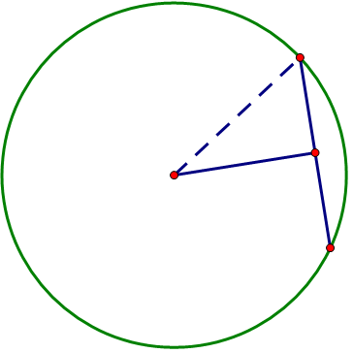
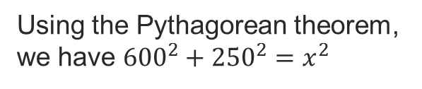



Example
You discovered a crop circle in a nearby farm. A chord of the circle is 500 feet long and 600 feet from the center of the circle. Find the length of the radius to the nearest foot.
Since the distance from a point (the center) to a segment (the chord) is always the length of the perpendicular segment, we know that the 600 ft segment bisects the 500 ft segment.
?
500 ft
600 ft
Using the Pythagorean theorem, we have ${600}^{2}+{250}^{2}=x^{2}$
$$360,000+62,500=x^{2}$$
$$425,000=x^{2}$$
$$650 ft≈x$$

Slide 8
Theorem
A
B
C
D

Slide 9
Theorem
F
A
B
C
E
G
D

Slide 10
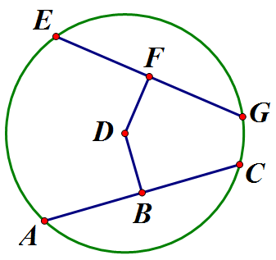
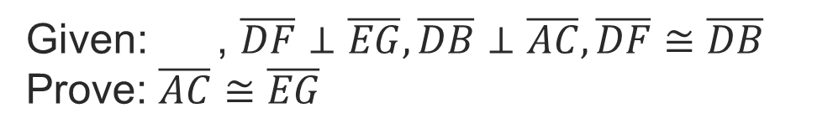
Example
Prove this condition of the theorem:
  In a circle, if two chords are equidistant from the center, then they are congruent.
Given: , $\overline{DF}⊥\overline{EG}, \overline{DB}⊥\overline{AC}, \overline{DF}≅\overline{DB}$
Prove: $\overline{AC}≅\overline{EG}$

Slide 11

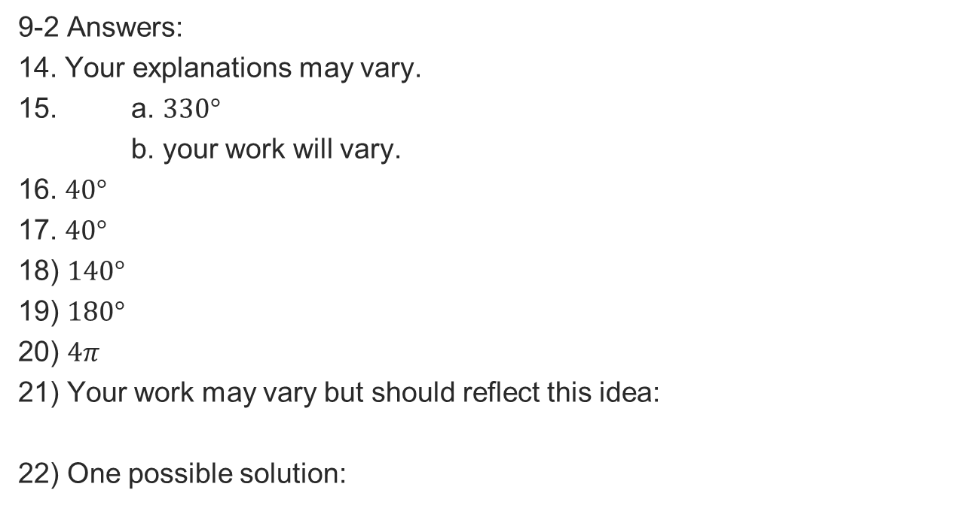






Homework Check
9-2 Answers:
14. Your explanations may vary.
15. a. $330°$
b. your work will vary.
16. $40°$
17. $40°$
18) $140°$
19) $180°$
20) $4π$
21) Your work may vary but should reflect this idea:
22) One possible solution:
Similar
$$A$$
$$E$$
Concentric
Congruent
$$B$$
$$D$$
$$∠ACE≅∠BCD$$
$$C$$
$$≇$$

